Slide 1
Topic 05: Data Model Diagram
BDM3302: Data Management

Slide 2

Data Models
There are three main popular data models which are
Entity Relationship Diagrams (E-R Diagrams)
Unified Modeling Language (UML)
Data Dictionary (will be used in DBM Tool Lab Class)

Slide 3
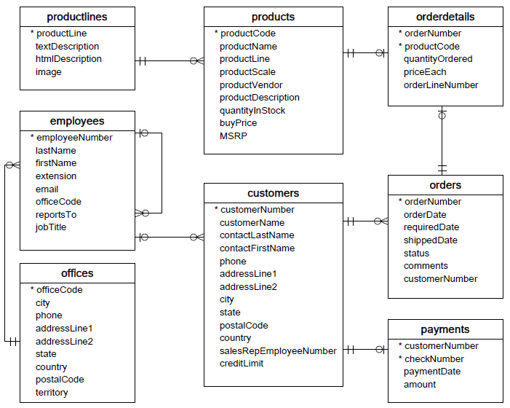
Entity Relationship Diagram (Classic Models)

Slide 4

Entity Relationship Diagrams (E-R Diagrams)
Entity-Relationship modeling is a default technique for modeling and the design of relational (traditional) databases. In this notation architect identifies:
Entities representing objects (or tables in relational database),
Attributes of entities including data type,
Relationships between entities/objects (or foreign keys in a database).
E-R Diagrams work well if you want to design a relational (classic) database, Excel databases or CSV files (tabular data). They work well for visualization of database schemas and communication of top-level view of data.

Slide 5
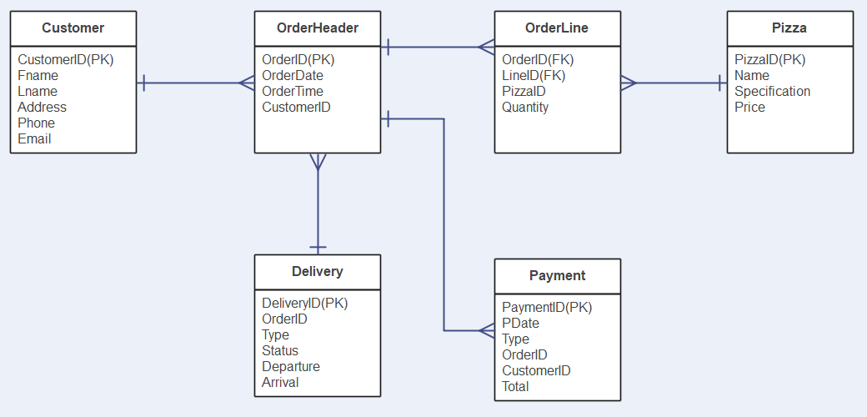
Entity Relationship Diagrams (E-R Diagrams)

Slide 6
UML Class Diagrams
UML (Unified Modeling Language) is a standardized family of notations for modeling and design of information systems. It was derived from various existing notations to provide a standard for software engineering or software developers.
Class diagrams are equivalent of ERDs in relational world and are mostly used to design classes in object-oriented programming languages (such as Java or C#).
In class diagrams architects define:
Classes (equivalent of entity in relational world),
Attributes of a class (same as in an ERD) including data type,
Methods associated to specific class, representing its behavior (in relational world those would be stored procedures),
Relationships grouped into two categories:
Relationships between objects (instances of Classes) differentiated into Dependency, Association, Aggregation and Composition (equivalent to relationships in an ERD),
Relationships between classes of two kinds Generalization/Inheritance and Realization/Implementation (this has no equivalent in relational world).

Slide 7
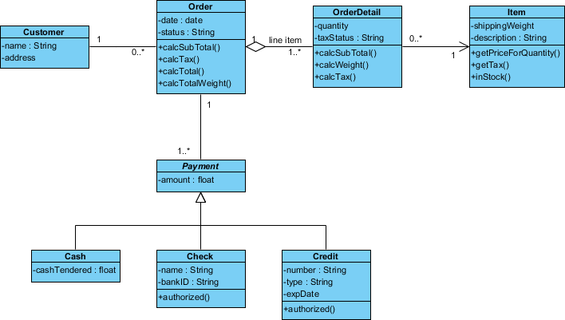
UMLDiagrams
class
Attribute
Methods

Slide 8
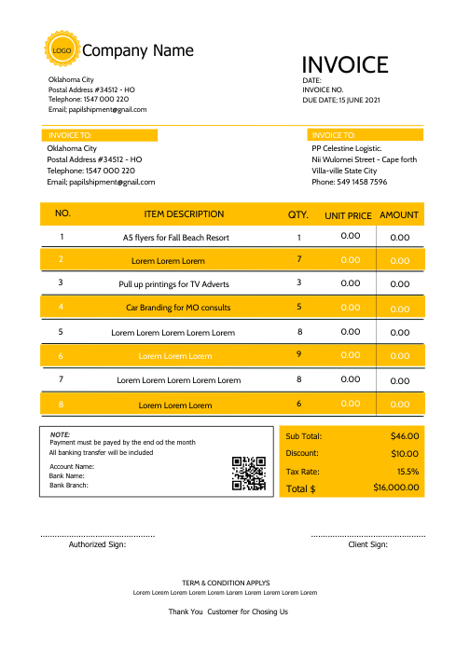
Business Document Sample (Invoice)

Slide 9

Data Modeling Tool
DBM Tool v.1.2.2 by Dr. Anan Osothslip (Download from LMS and unzip file).
It is the tool that introduces how data can be constructed and converted into the SQL and database tables.
The input can be JSON only that process the output into SQL and database tables.
This tool also provides catalog, departments, roles, positions, users, processes, and assets in order to identify what kind of these data to support your business (will use in Data Accessibility lab class later).
The Internet connection is also required for this tool.

Slide 10
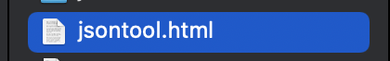
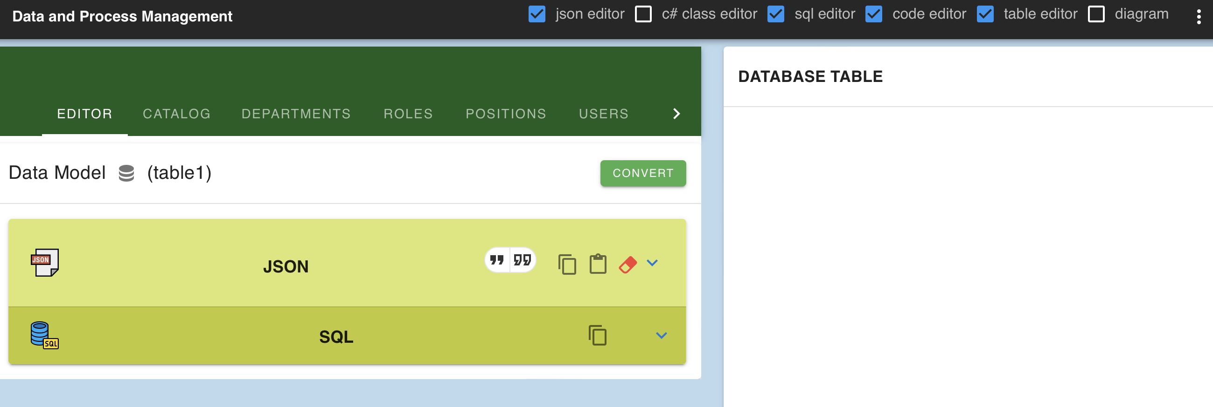
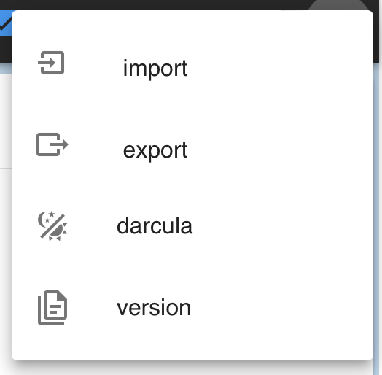
Data Modeling Tool Overview
Please uncheck this check box first!
Double click to open
Import/Export file
Menu Selection
Data Model Name
Convert button
JSON Input Area
SQL Output Area
Database Table Output Area

Slide 11
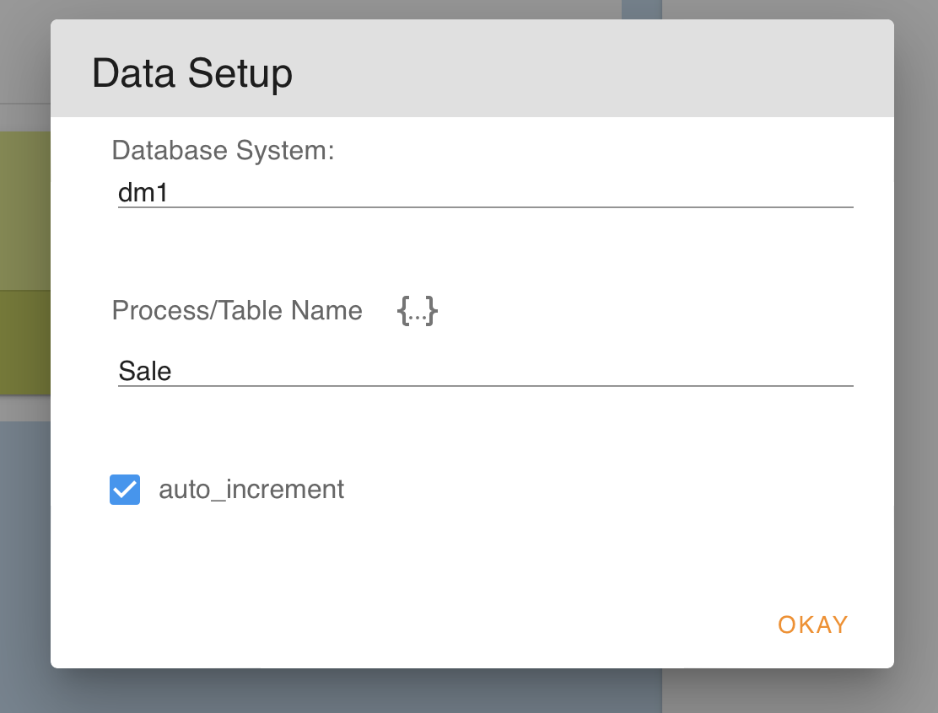
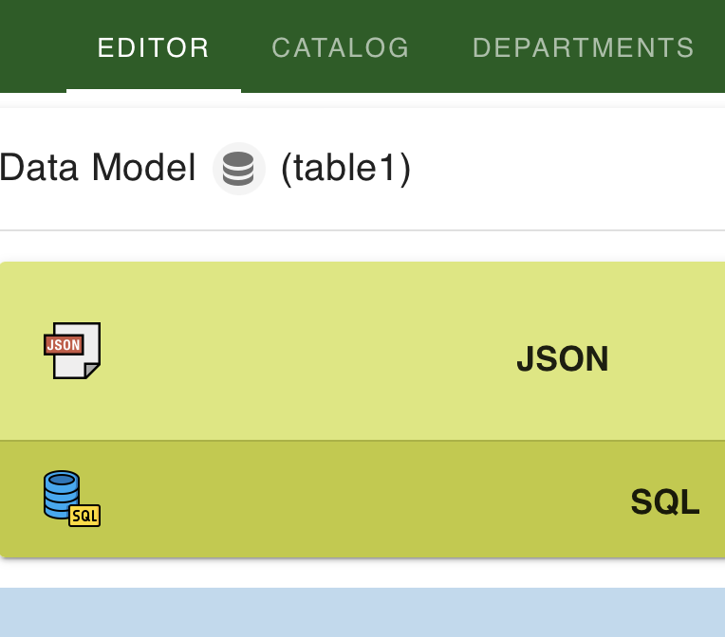
Data Modeling Tool (Lab for beginners)
First, let’s try to create Data Setup from “table1” to ”Sale”.

Slide 12
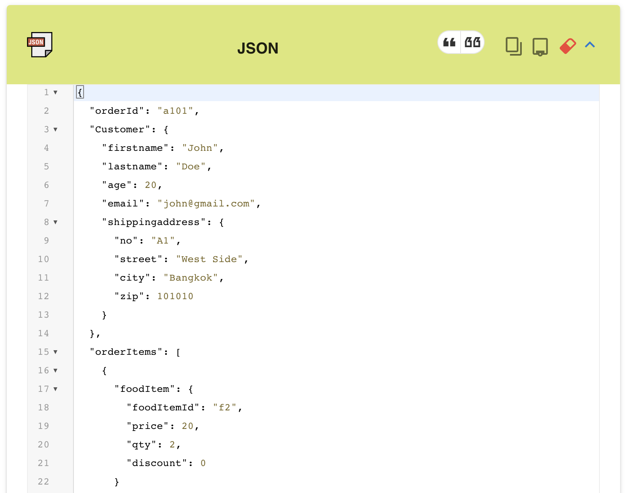
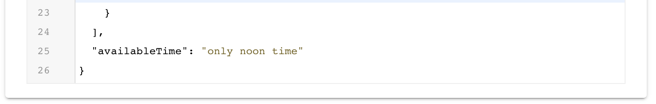
Data Modeling Tool (Lab for beginners)
Second, try to input sample JSON how customer orders food.

Slide 13
Data Modeling Tool (Lab for beginners)
JSON structure explains …
Stands for JavaScript Object Notation
It is a text format for storing and transporting data
It is a “self-describing” and easy to understand
The example looks like this:
{
“name”: “John”,
“age”: 30,
“car”: “Toyota”
}
It identifies with 3 properties:
name = John (text)
age = 30 (integer)
car = Toyota (text)
*Each property has a value
“Mr. John with age of 30 years old has got a Toyota car.”

Slide 14
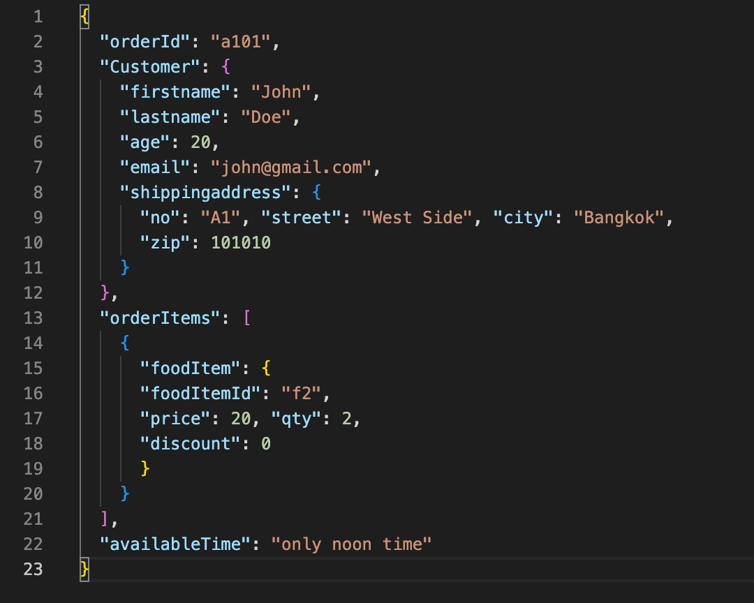
Data Modeling Tool (Lab for beginners)
JSON structure explains …
“Mr. John Doe would like to order two f2 foods for price $20 each and deliver to his home only noon time.”

Slide 15
Data Modeling Tool (Lab for beginners)
JSON structure explains …
Information name
Data type: object/table
Data type: list
Data type: text
Data type: integer

Slide 16
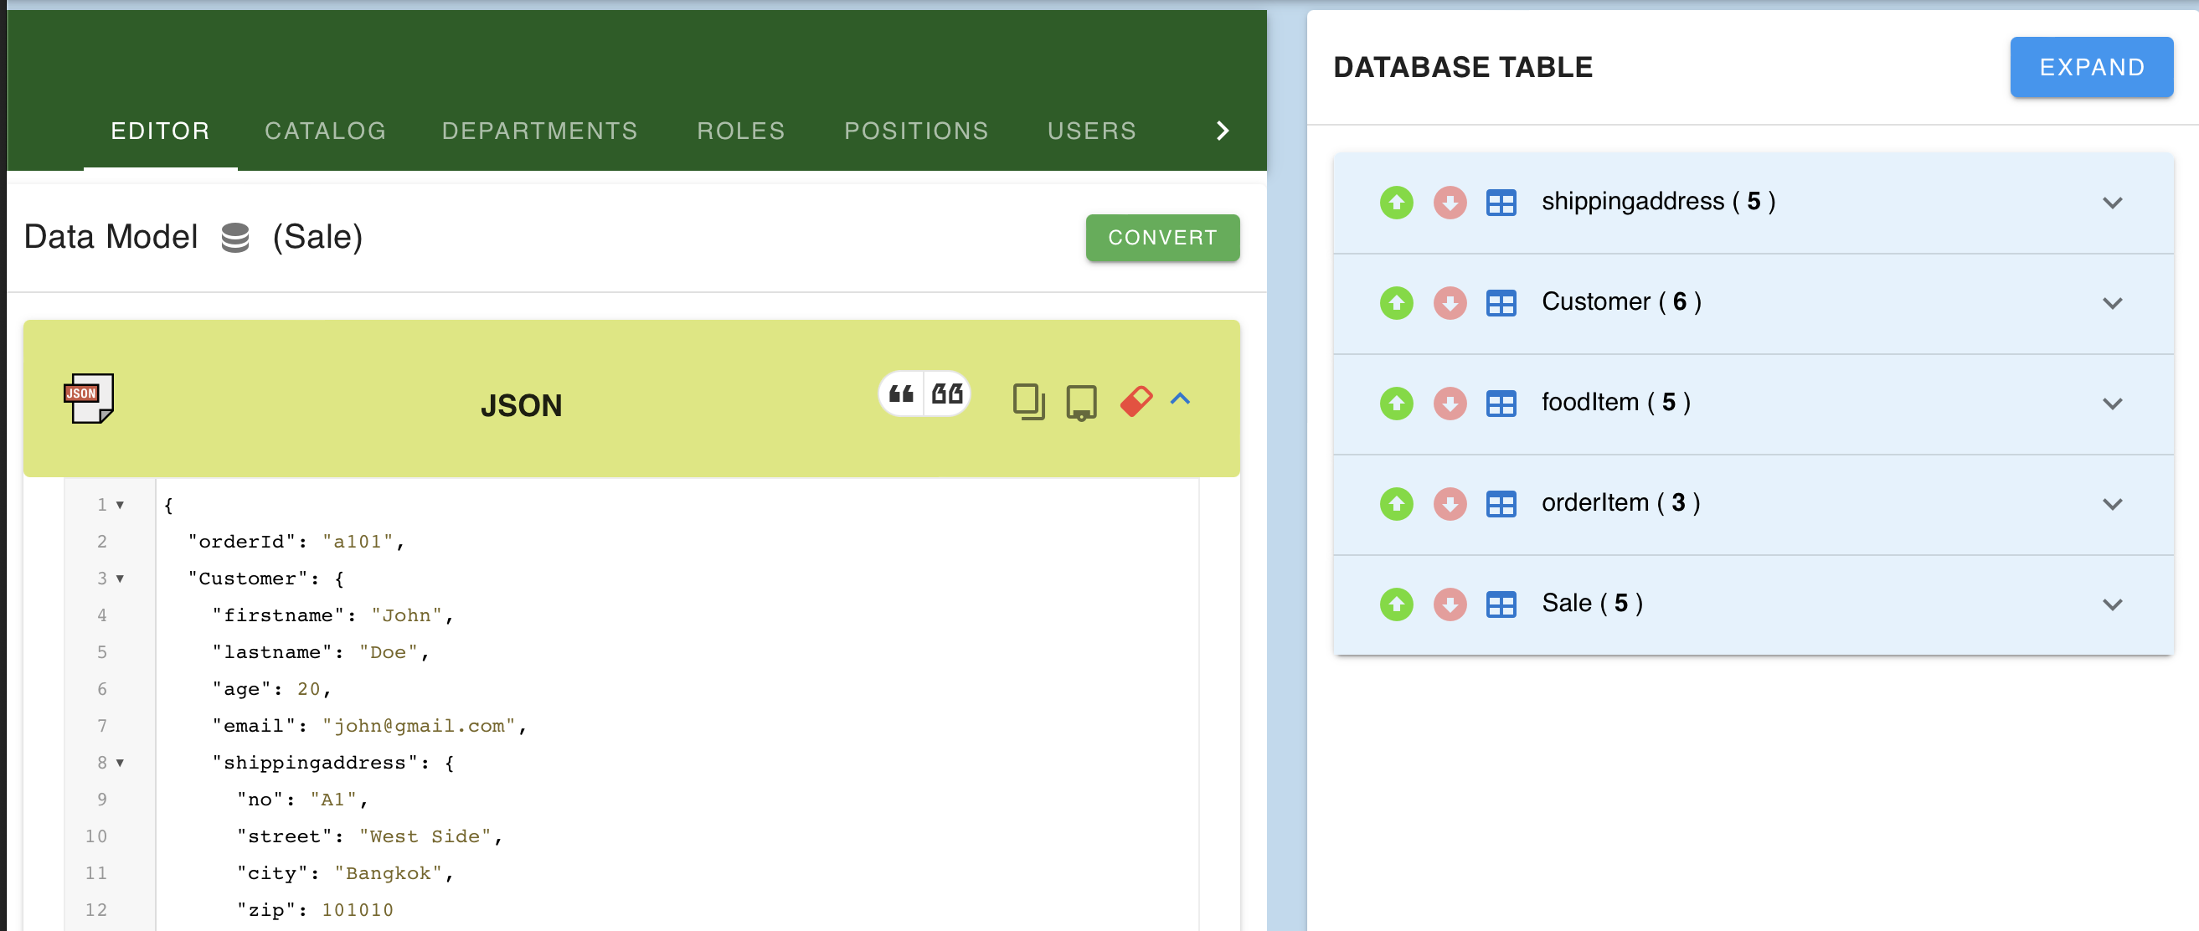
Data Modeling Tool (Lab for beginners)
Third, try to click convert button and see the result.

Slide 17
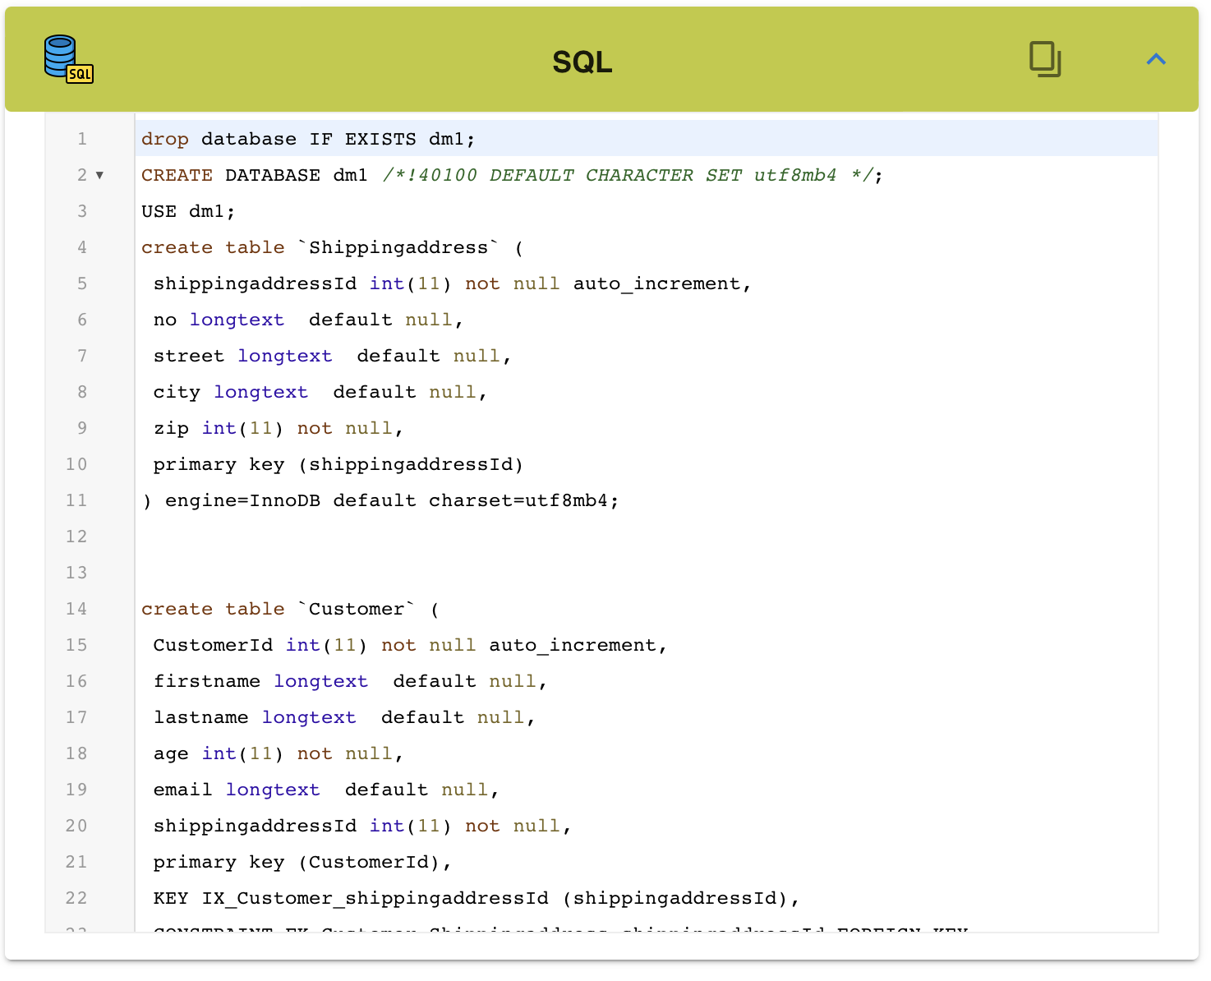
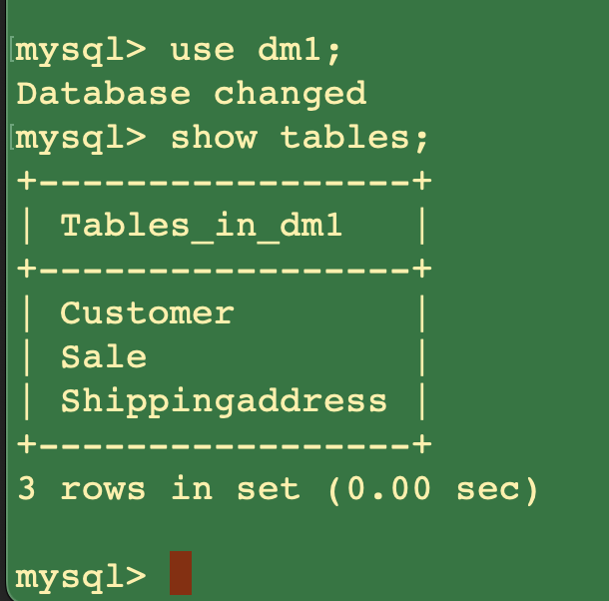
Data Modeling Tool (Lab for beginners)
Somehow, you will see SQL appear when JSON is converted. You may bring SQL to create .sql file and try to import into “mysql” also (Empty).

Slide 18
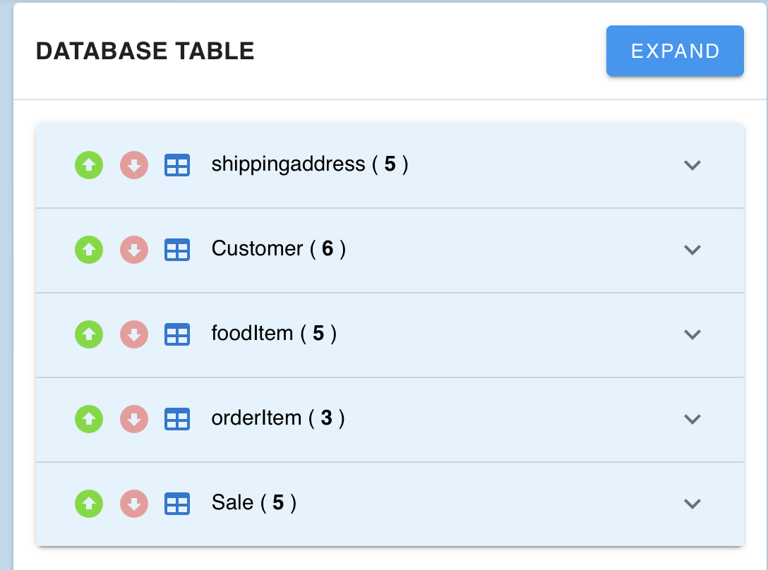
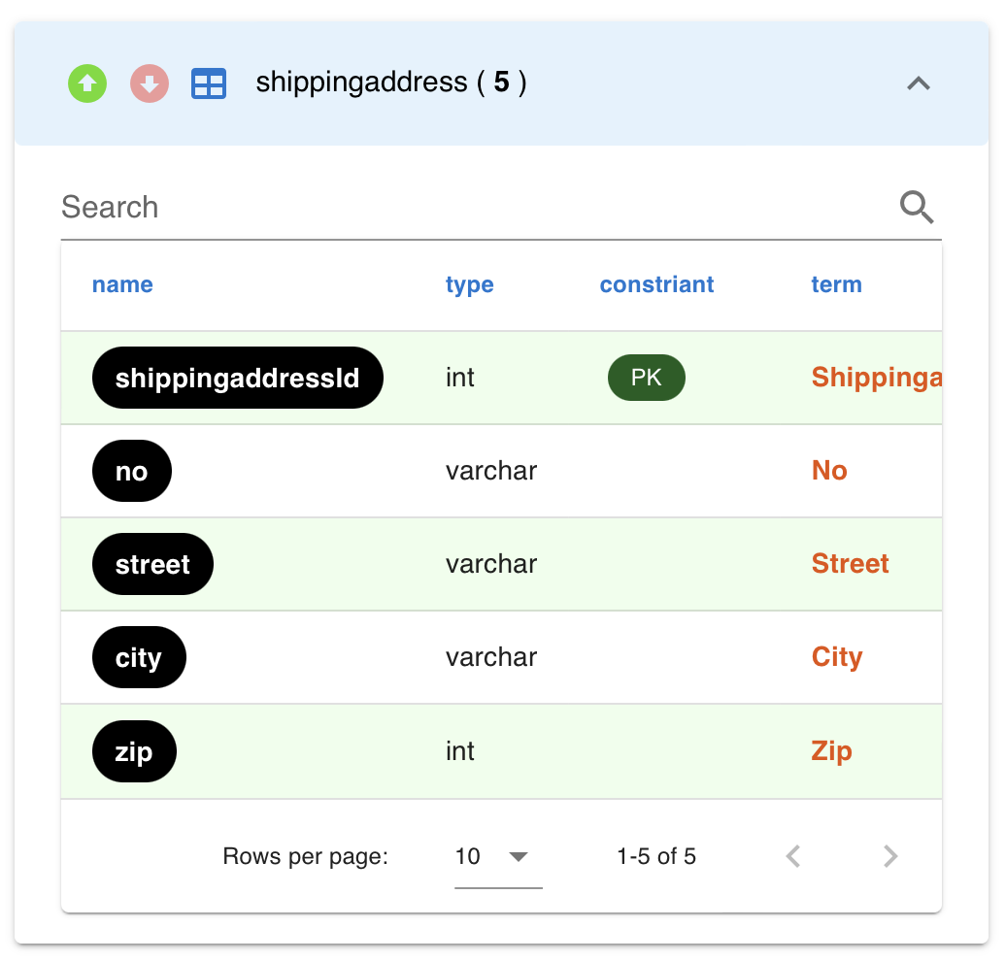
Data Modeling Tool (Lab for beginners)
Four, let’s try to click Expand button. You will see each table displays data dictionary for each field. (e.g., shippingaddress)

Slide 19
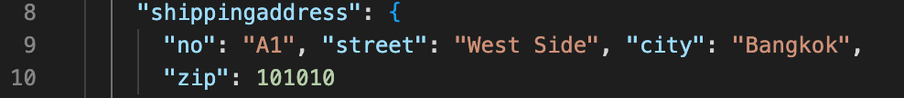
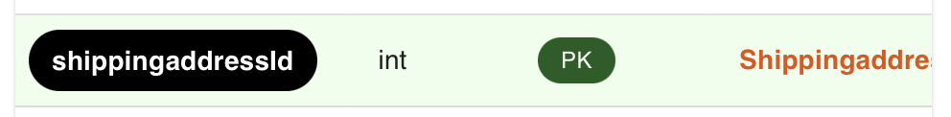
Data Modeling Tool (Lab for beginners)
Five, try to click name item to open Data Catalogs which displays in Catalog menu.
Click this item to open Data Catalogs
Primary Key
Term

Slide 20
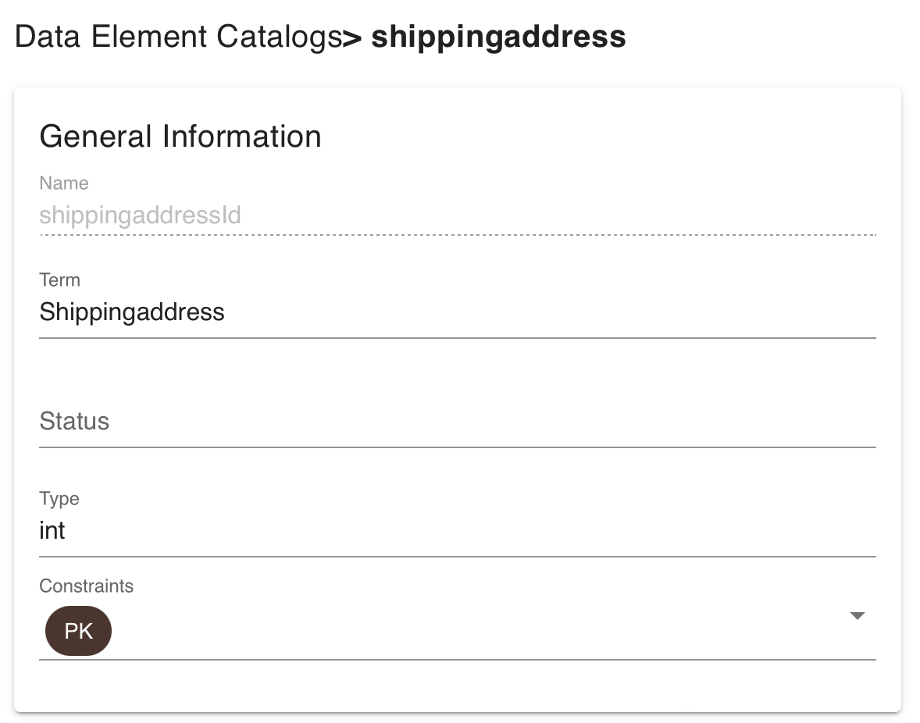
Data Modeling Tool (Lab for beginners)
Display Data Catalogs for “shippingaddressId”.
Try to click other name items in each table to open Data Catalogs and see the different result …
Use to type the description

Slide 21
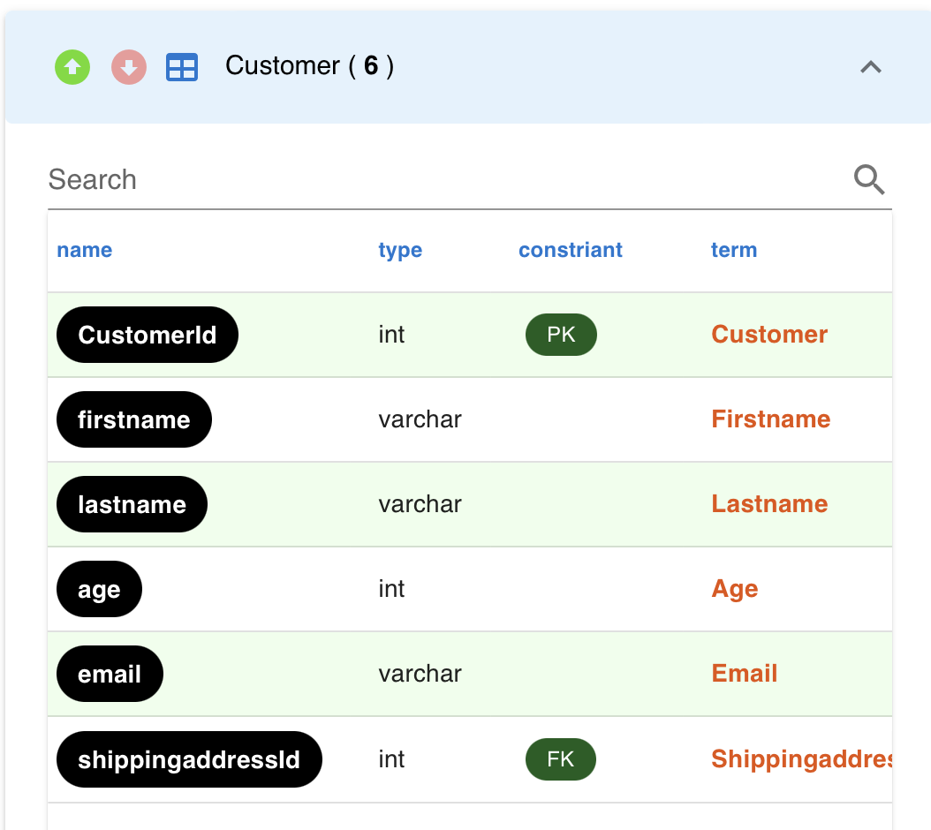
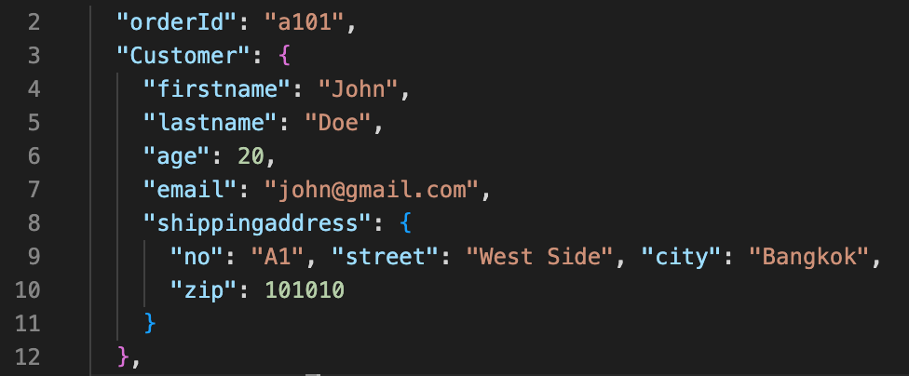
Data Modeling Tool (Lab for beginners)
Six, let’s see inside the Customer table (one-to-one relationship).
Why does “shippingaddressId” appear as a foreign key inside Customer table?

Slide 22
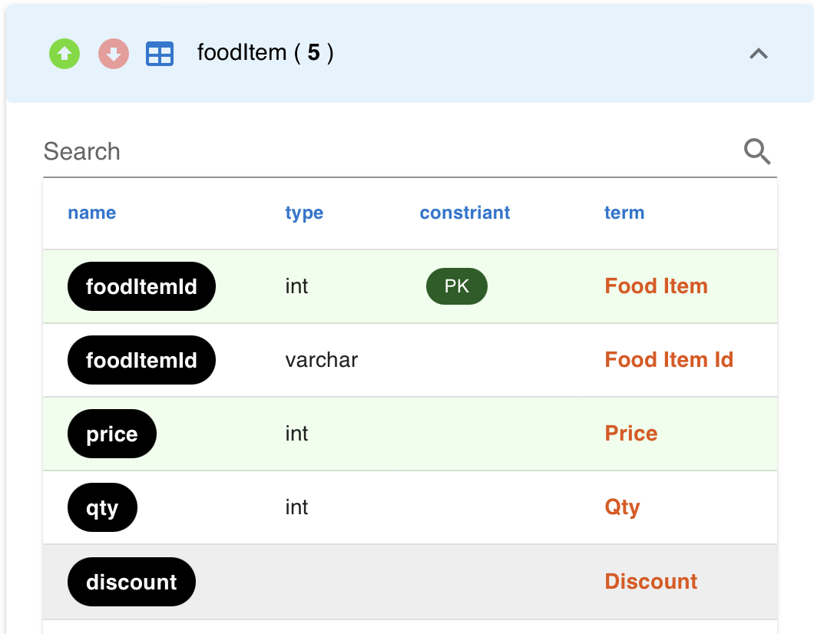
Data Modeling Tool (Lab for beginners)
Seven, let’s see inside the foodItem table (subset of orderItems).
See the colors inside each layer which corresponds to JSON

Slide 23
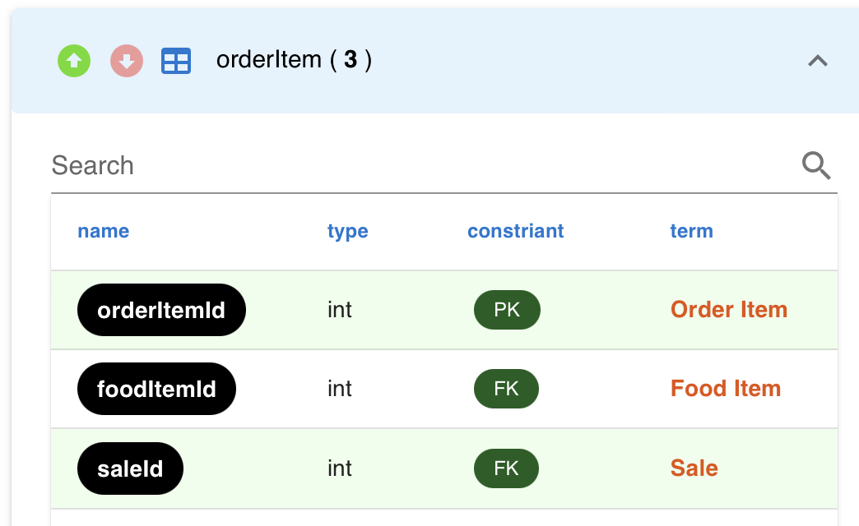
Data Modeling Tool (Lab for beginners)
Eight, let’s see inside the orderItems table (many-to-many relationship).
See the colors inside each layer which corresponds to JSON

Slide 24
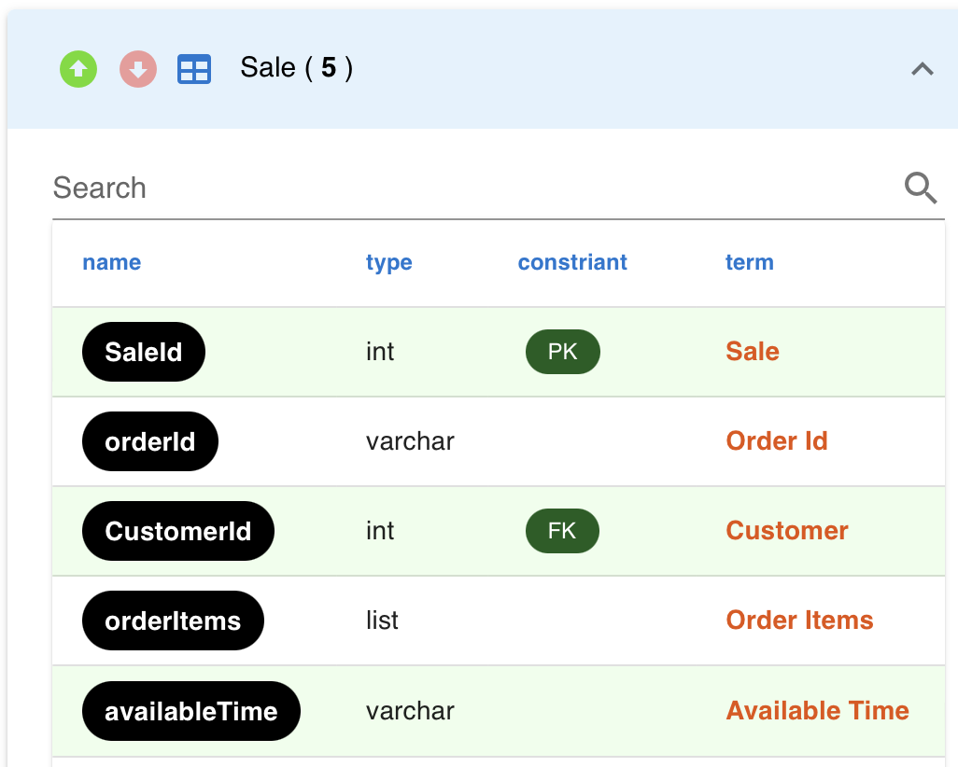
Data Modeling Tool (Lab for beginners)
Nine, let’s see inside the Sale table (one-to-many relationship).
See the colors inside each layer which corresponds to JSON

Slide 25
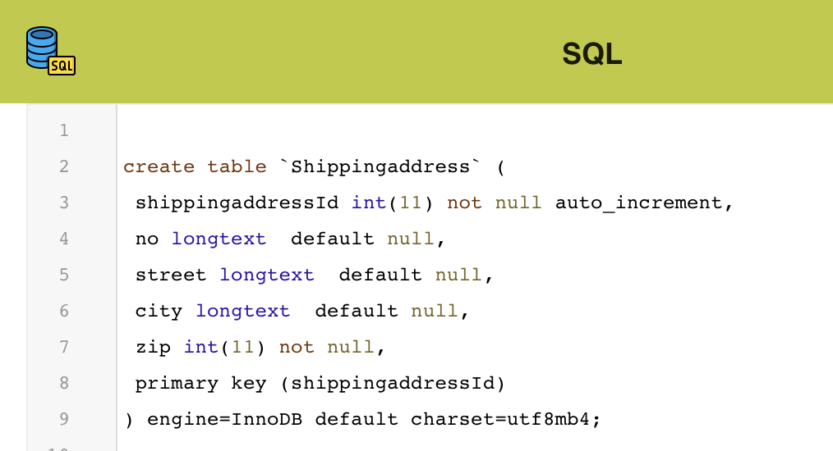
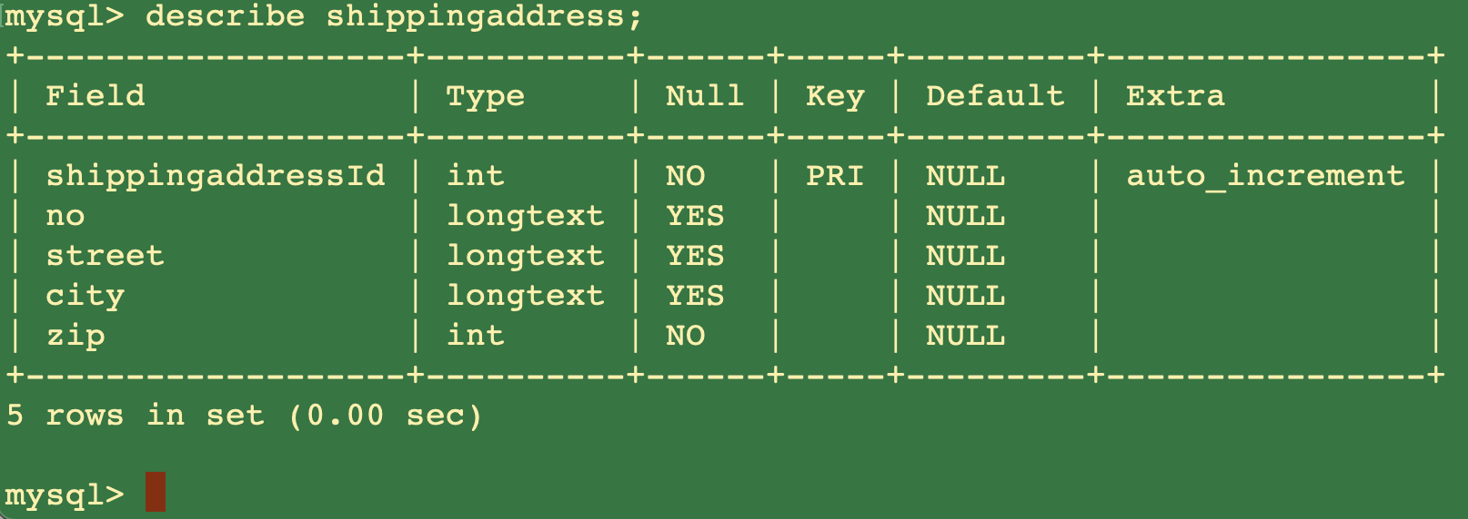
Data Modeling Tool (Lab for beginners)
Moreover, you can see the SQL view with an empty record.
How is JSON different from SQL?

Slide 26
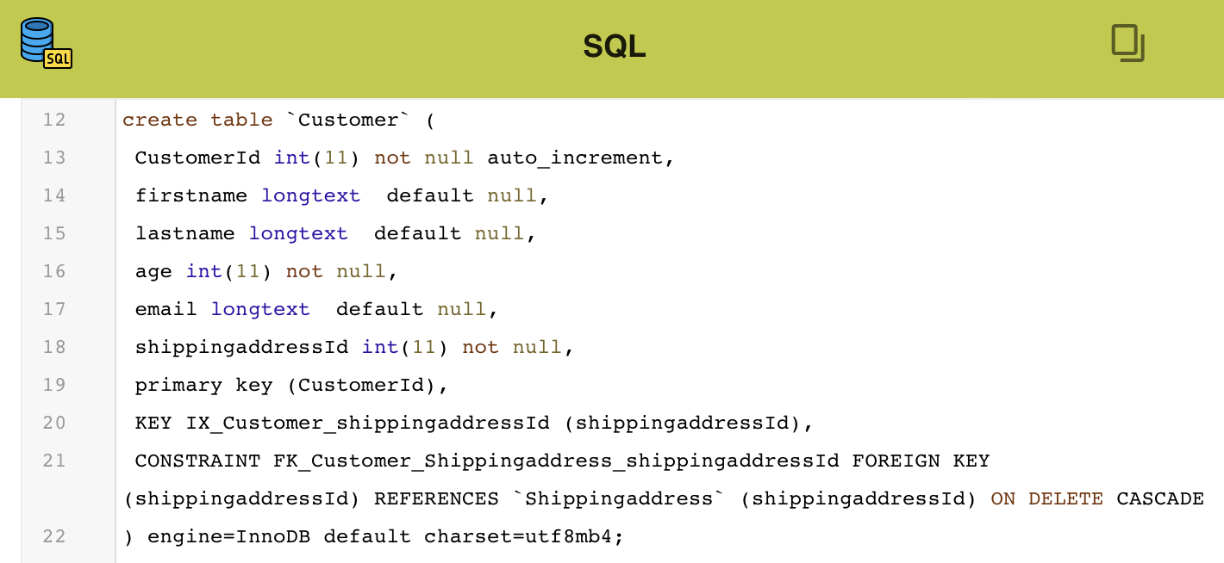
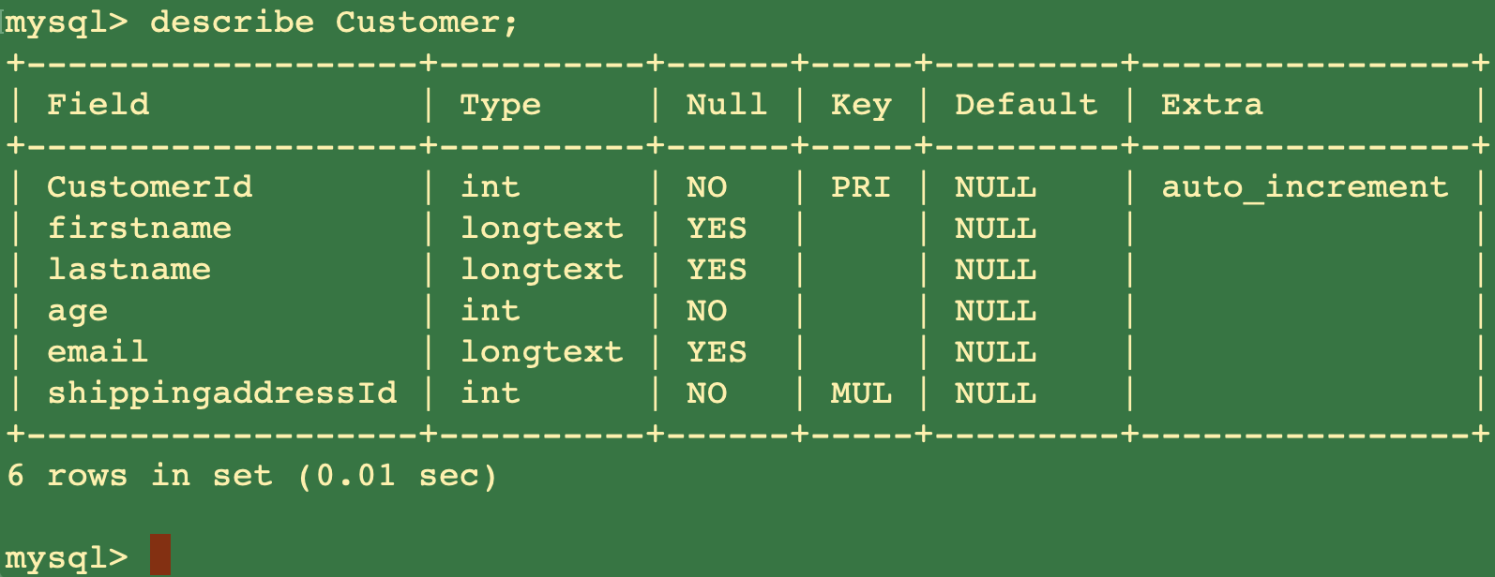
Data Modeling Tool (Lab for beginners)
Moreover, you can see the SQL view with an empty record.
How is JSON different from SQL?

Slide 27
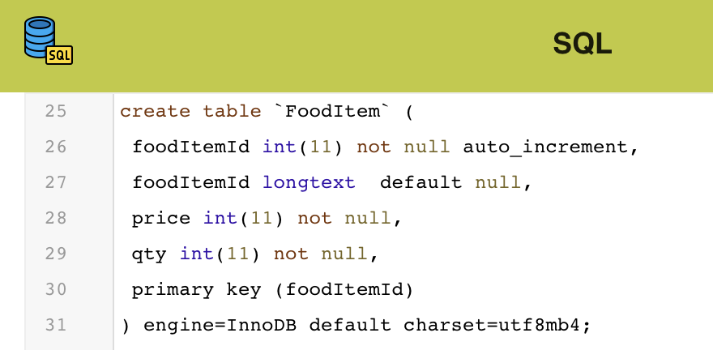
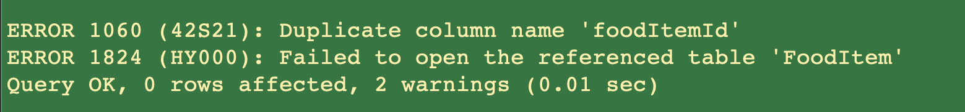
Data Modeling Tool (Lab for beginners)
Moreover, you can see the SQL view with an empty record.
foodItem table cannot be include in mysql (Need fixing a bit) …
How is JSON different from SQL?

Slide 28
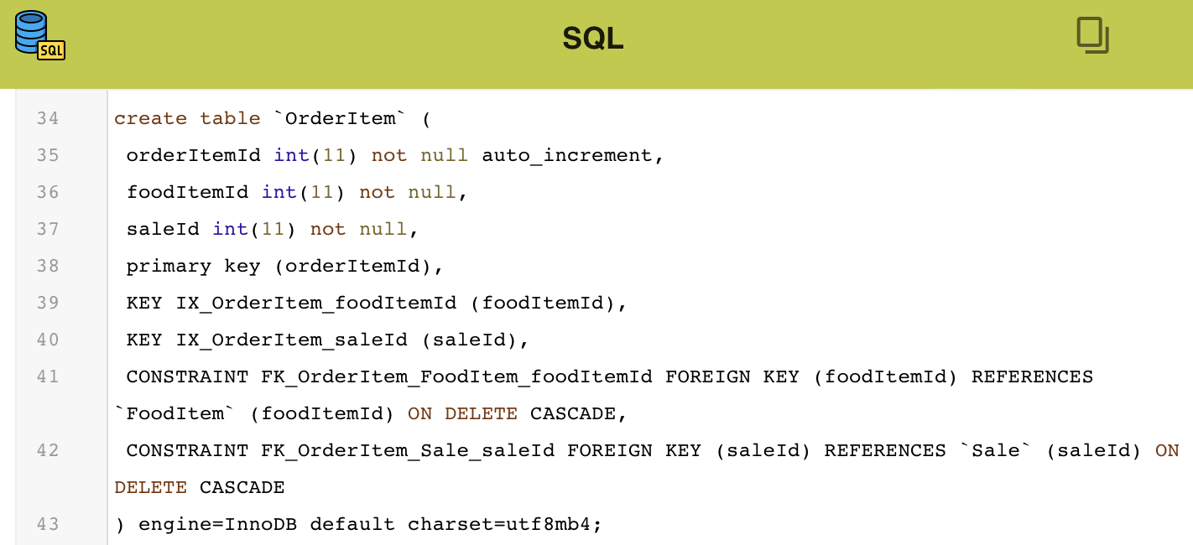
Data Modeling Tool (Lab for beginners)
Moreover, you can see the SQL view with an empty record.
orderItem table cannot be include in mysql (Need fixing a bit) …
How is JSON different from SQL?

Slide 29
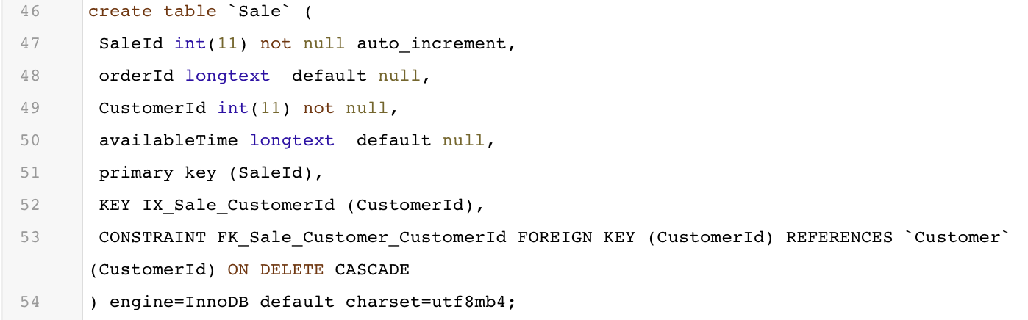
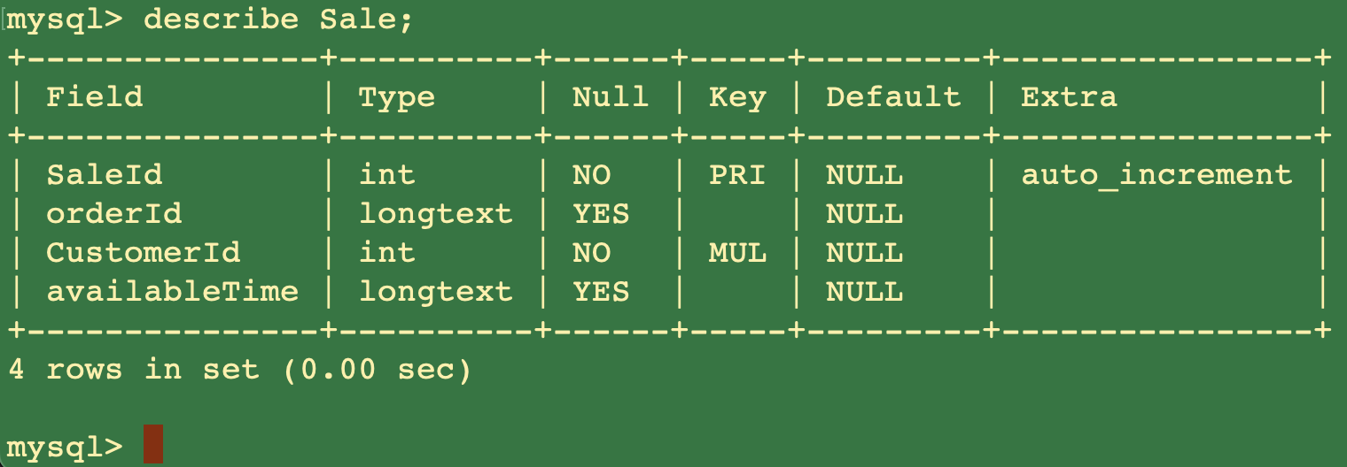
Data Modeling Tool (Lab for beginners)
Moreover, you can see the SQL view with an empty record.
How is JSON different from SQL?

Slide 30
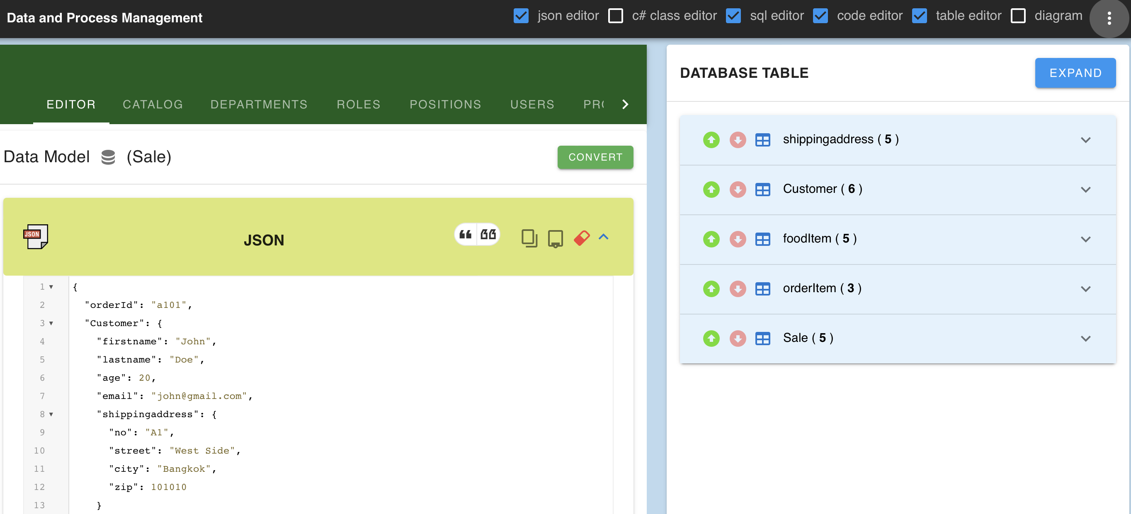
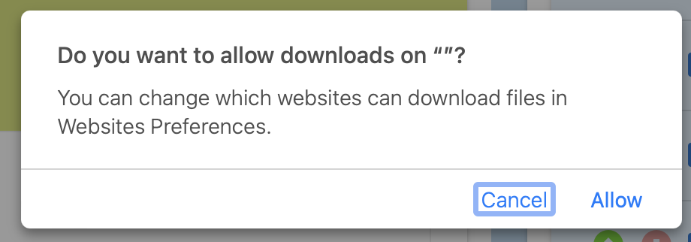
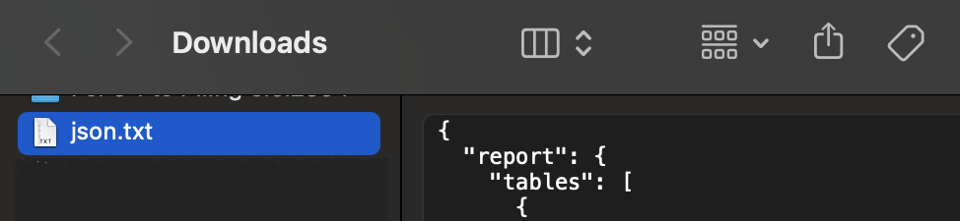
Data Modeling Tool (Lab for beginners)
Export file to json.txt
Click this circle button and choose export
You can rename json.txt to others and keep in safe to import later :)

Slide 31
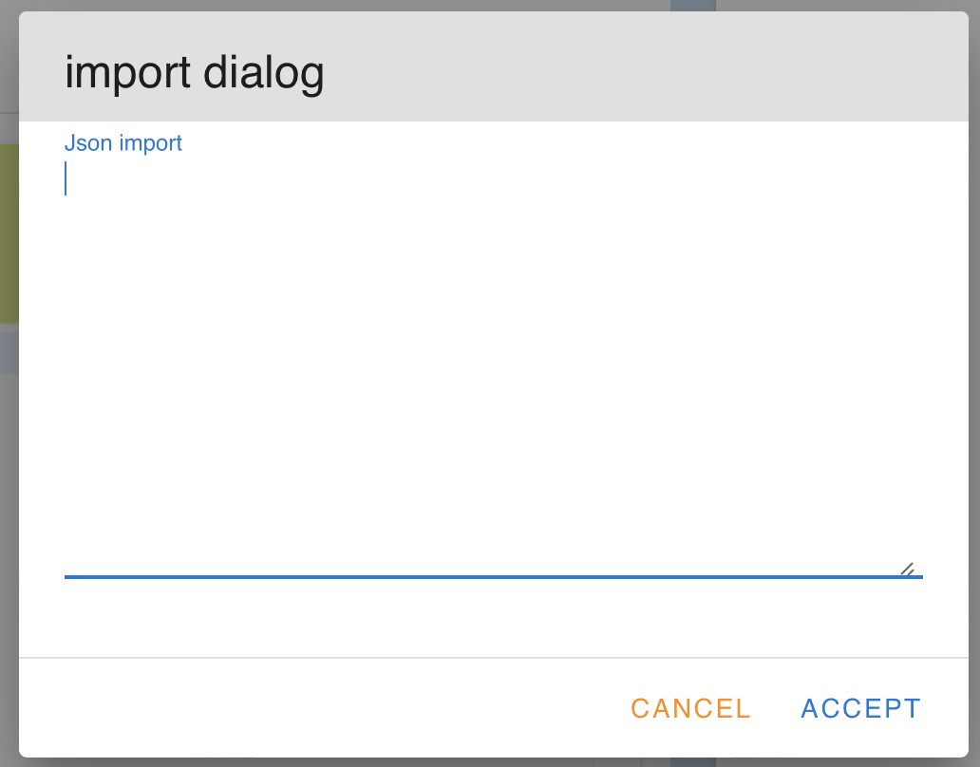
Data Modeling Tool (Lab for beginners)
Import file into DBM Tool.
Click this circle button and choose import
The import dialog will display

Slide 32
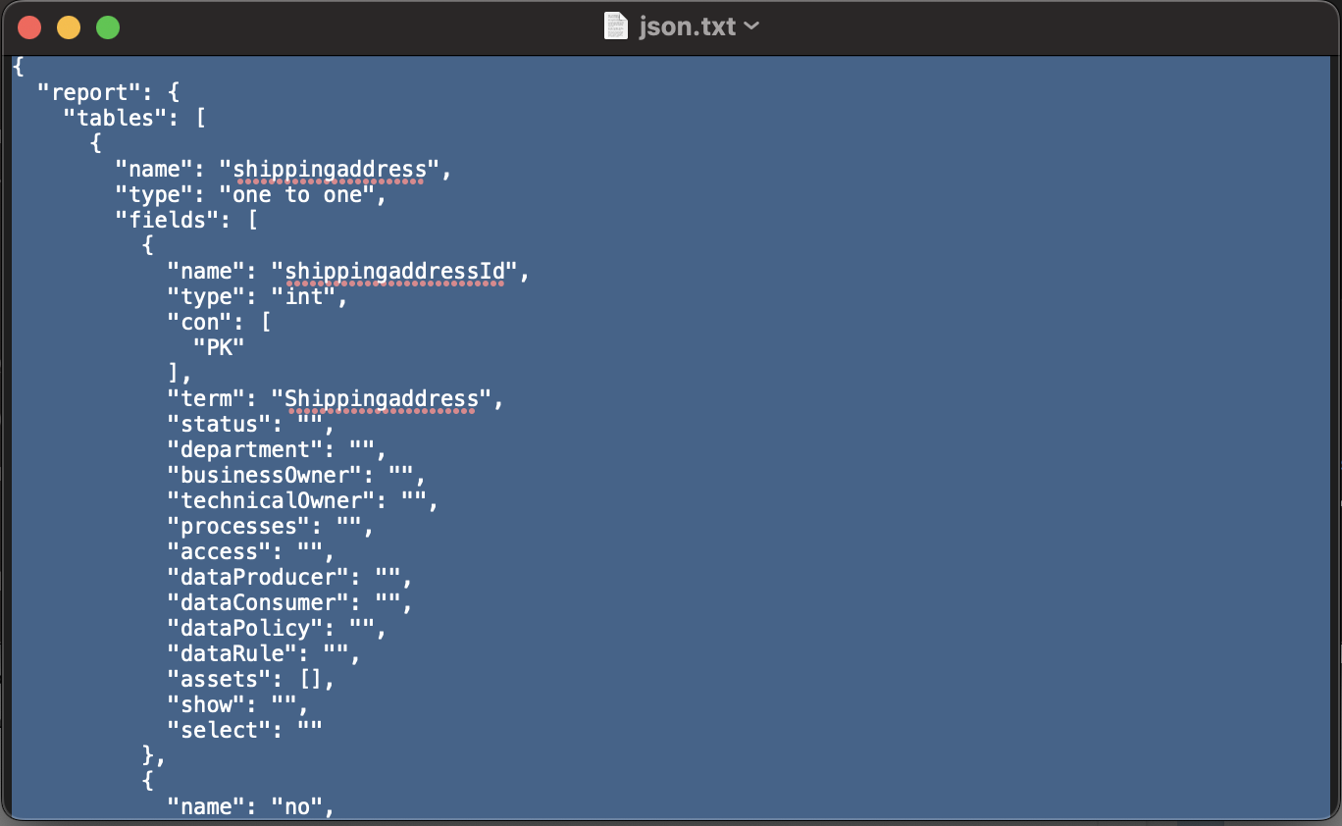
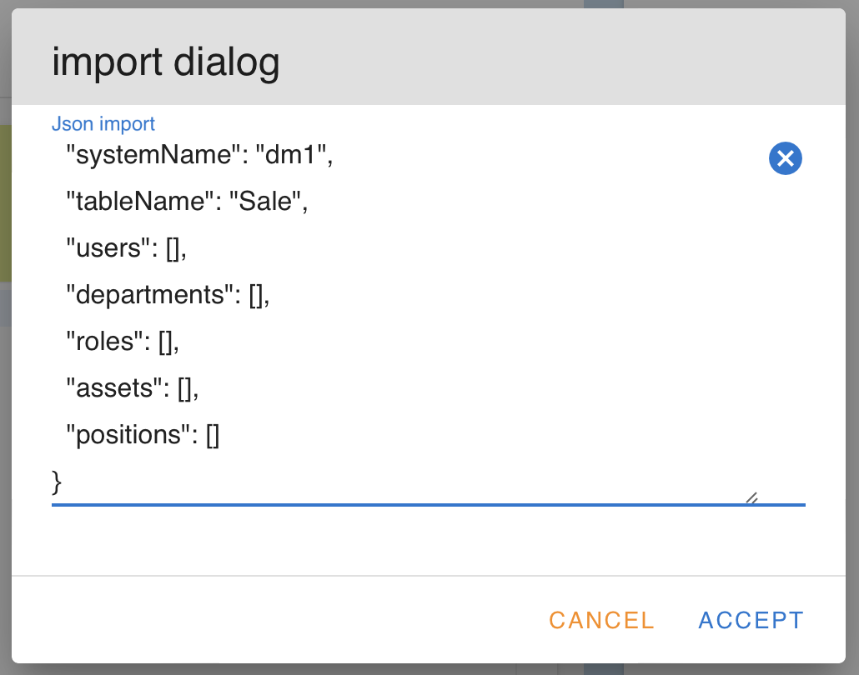
Data Modeling Tool (Lab for beginners)
Import file into DBM Tool.
Step for importing file:
Open json.txt into Notepad or TextEdit App
Use hotkey “Ctrl + A” to select all texts
Use hotkey “Ctrl + C” to copy
Click in the text area of import dialog
Use hotkey “Ctrl + V” to paste and click ACCEPT

Slide 33
Data Modeling Tool (Lab for beginners)
Let’s try this (In class).
Interpret this business communication phrase into JSON. Then use DBM Tool to convert and see the different result:
“Ms. Evangeline McDowell would like to rent a Honda Civic, plate 2AB1820, year 2016 with dark silver color for 2,000 baht a day to drive in Phuket for 3 days. (Hint: rentId is “R1301”)
She is 24 years old and lives in 1135 Ladphrao 81 Wangthonglang Wangthonglang Bangkok 10310, and phone number is 0954220896”

